Slide 1

Grupo Numero Dos

Slide 2
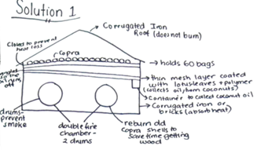
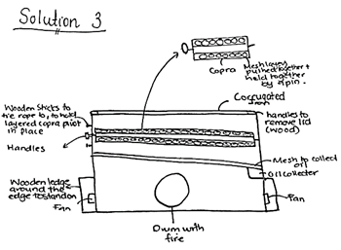
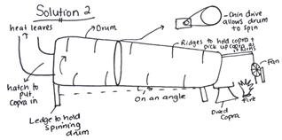
Problem + Alternative Solutions
Problem:
The copra drying process used in East Santo is currently inefficient. This means households do not receive their income in time to pay for their children's education fees.
Top 3 Alternative Solutions:

Slide 3
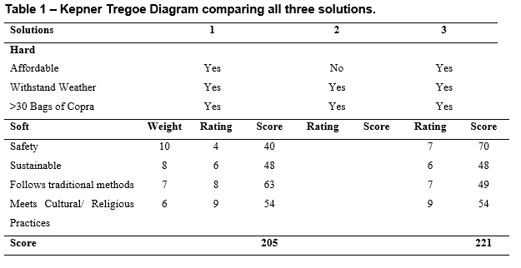
Selection Process
Analysis of top 3 Alternative Designs
Pros and Cons of Each Alternative Design

Slide 4
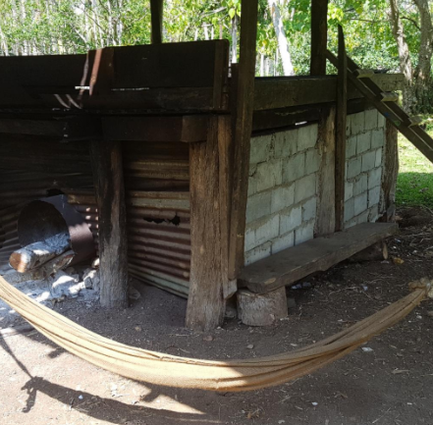
The Selected Design

Slide 5
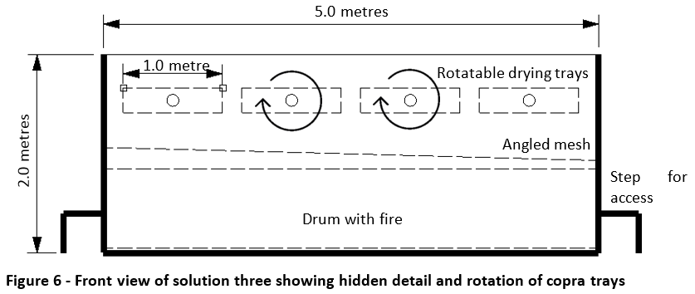
The Selected Design

Slide 6
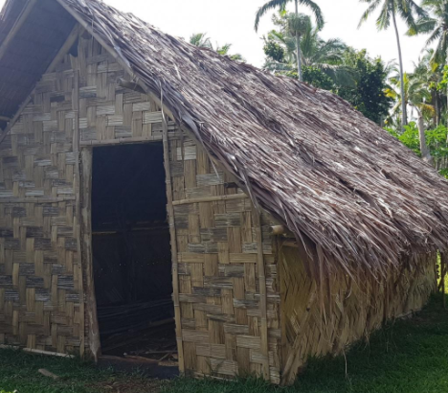
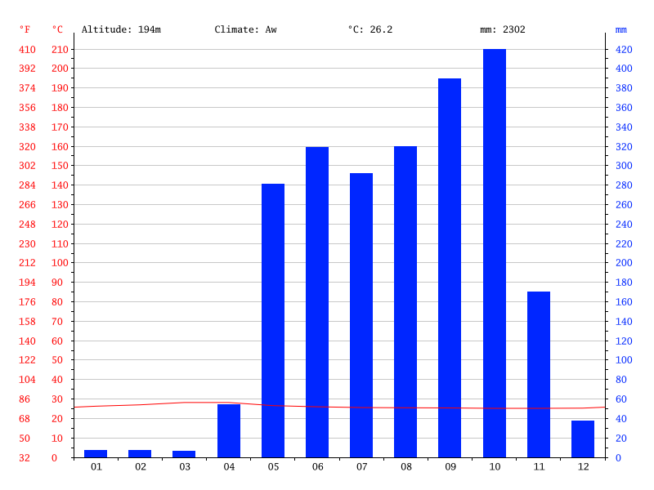
How our Design Will Fit the Environment
Housing in Vanuatu
Climate in Vanuatu

